Slide 1


Comparing Analysis Method Implementations in Software (CAMIS)
Lyn Taylor
June 2023
Notes:
Thank you for joining this session which will give an introduction to the PHUSE / PSI / R Consortium collaboration project “CAMIS”.
The QR code on screen will take you to the website for more information and I’ll put it up again at the end of the presentation.

Slide 2
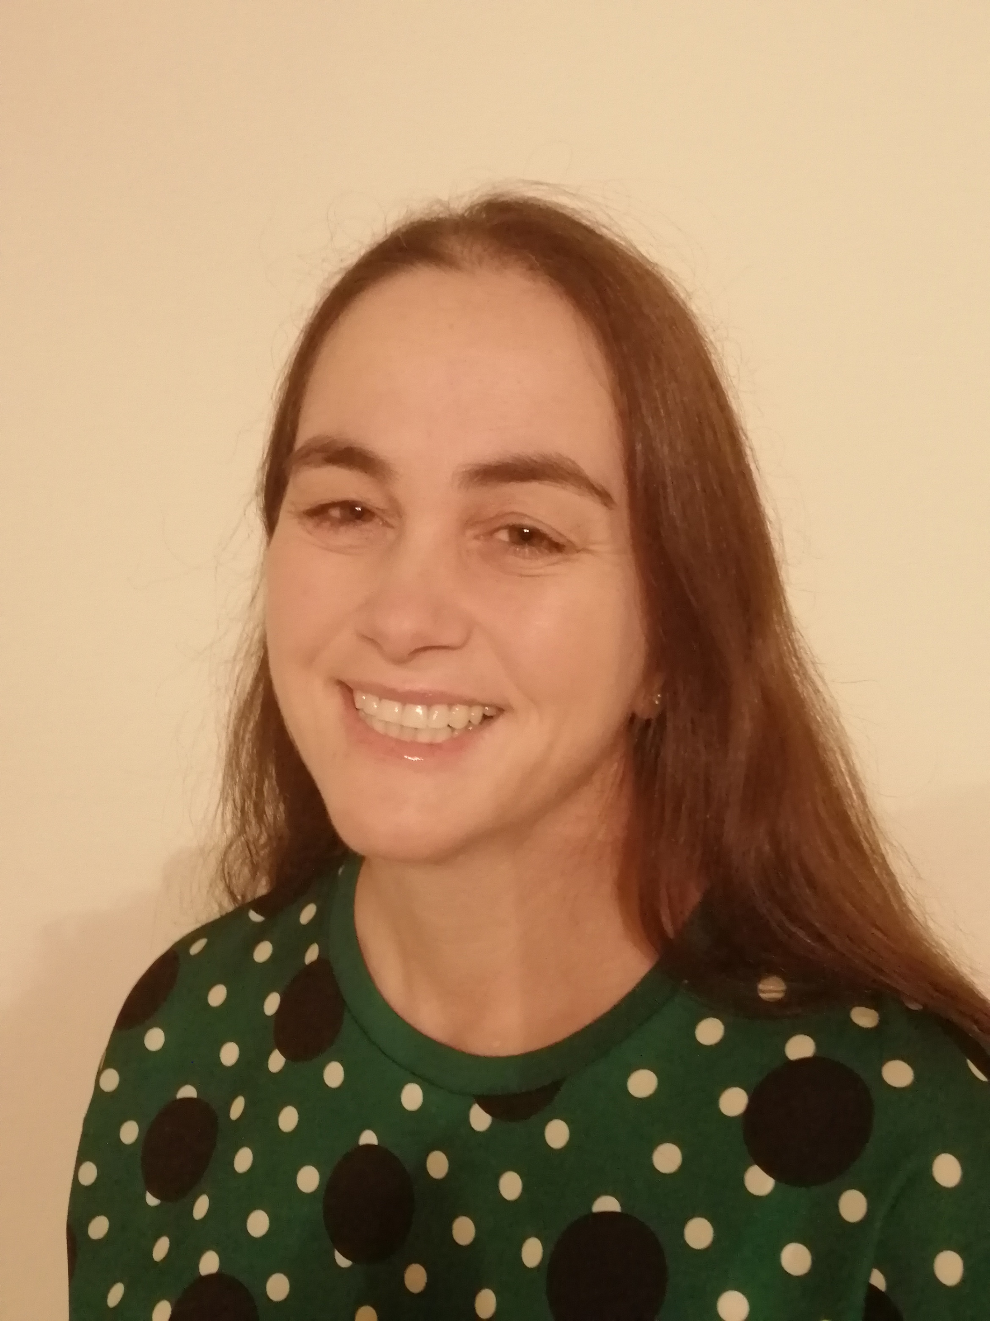
Meet Lyn
Born in the 70’s
Learnt minitab, GLIM, MATLAB, SAS, SPSS, statistica and S-PLUS at university
20 years later SAS programming at a CRO
Heard of R – but lack of validation scares her
Lyn Taylor
Fun Fact: Thinks “github” is a coffee shop
Associate Biostatistics Director
Notes:
Let’s jump straight into the life of a statistician by using a case study example !
This is Lyn. Lyn was born in the 70s and learnt minitab, GLIM, Matlab, SAS, SPSS, statistica and S-PLUS software at university.
She’s been working in the pharmaceutical industry doing statistical analysis in SAS for over 20 years.
She’s heard about R, but never found need to use it at her workplace. The lack of validation of the packages scares her !
When asked about github, she wondered if it was the coffee shop hub meeting that the “Group Information Technology” team go to?

Slide 3
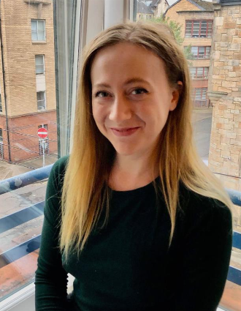
Meet Molly
Born in the 90’s
Learnt R, python, matlab and SPSS at university
Graduated 2022 and started a job at a Contract Research Organization (CRO)
Molly MacDiarmad
Fun Fact: Thought SAS was her Student Awards Agency Scotland (SAAS)
Biostatistician I
Notes:
This is Molly.
Molly was born in 1990’s, she learnt R primarily at university with matlab, SPSS and a bit of Python
She graduated in 2022, and started a new job at a CRO and was keen to get analyzing data in the real world.
When asked about SAS, she thought it was the Student Awards Agency Scotland – who provide financial student loans to students in scotland.

Slide 4
Project 12345 – Year 2022
Kaplan-Meier plots of Overall Survival will be presented by treatment group.
Overall survival will be analyzed using a stratified log-rank test with hazard ratio and 95% CI from the cox-proportional hazards model
Client is software agnostic but needs the analysis today !
Molly and Lyn are assigned to do the Production and independent QC
Molly decides to use R
Lyn decides to use SAS
Notes:
The year is 2022:
A project gets assigned to Molly & Lyn to program and QC independently.
It’s a really simple analysis of Overall survival using Kaplan meier estimates, cox proportional hazards modelling and a log-rank test.
Kaplan-Meier plots of Overall Survival will be presented by treatment group.
Overall survival will be analyzed using a stratified log-rank test with hazard ratio and 95% CI from the cox-proportional hazards model
Client is software agnostic but needs the analysis today !
Lyn’s done these 1000’s of times before in SAS, expects to be home on time tonight.
Molly’s never done this in SAS before, but has used R on her university course, so decides it will be quicker for her to use R to do the work.

Slide 5
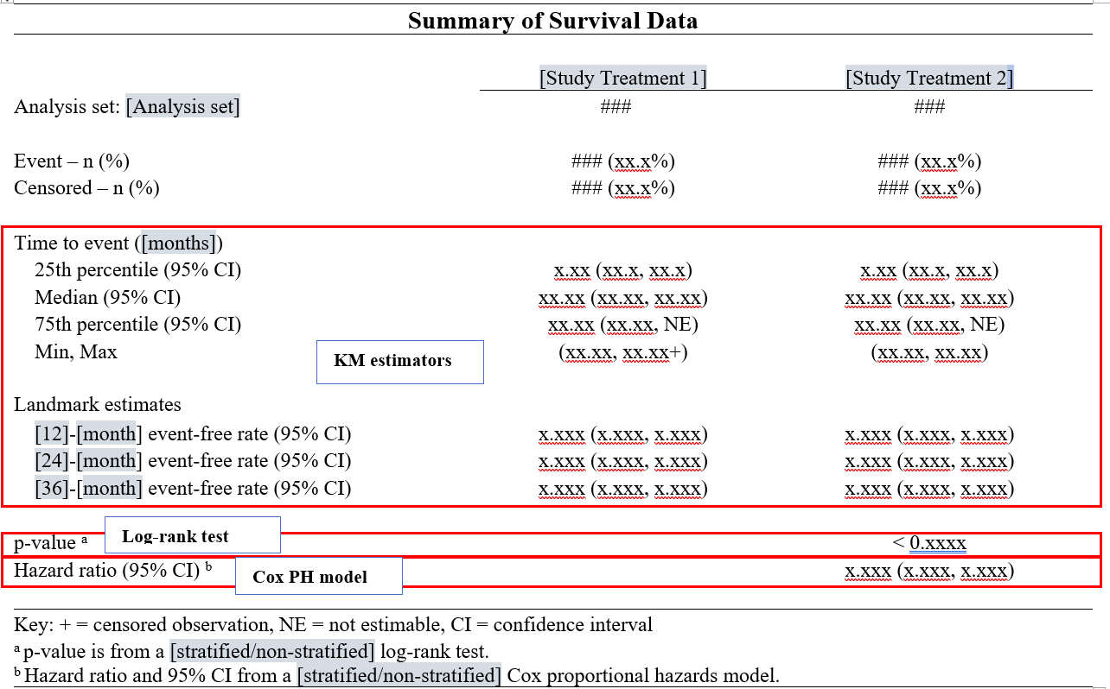
Project 12345 – Shell required
With Thanks to Mia Qi & Min-Hua Jen
Notes:
Here is the shell they’ve been provided with.

Slide 6
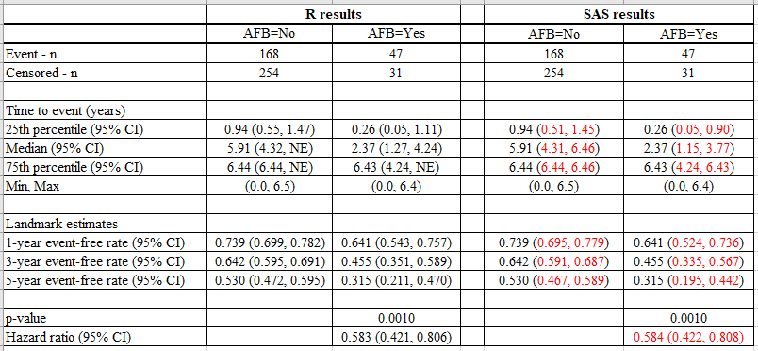
Project 12345 – R vs SAS Results
With Thanks to Mia Qi & Min-Hua Jen
Notes:
Molly and Lyn output a dataset containing the results, but some do not agree?
They compare input datasets – which are identical so the discrepancy must be because R & SAS are doing something differently?
But
Which is correct?
Who needs to change their code & how?
What do they do now?

Slide 7


Project 12345 – Year 2022 Panic !!
Work icons created by By Freepik - Flaticon
Notes:
In the year 2022… this may lead to a Panic and a lot of stress.
Considerable investigation of the documentation supporting the R package Molly is using would be needed. This would then need comparing to the SAS manuals/website to try to determine why the differences exist.
It could lead to missing the deadline required by the client.

Slide 8


Project 12345 – Year 2023
Work icons created by Eucalyp - Flaticon
Notes:
However, lets fast forward to 2023 !!
Molly and Lyn Access the CAMIS website.
They consult the CAMIS repository Survival analysis pages, they find the problem is already documented there and hence know what to do to fix the discrepancy.
The issue is resolved & they both leave work early, having delivered a high quality package to the client.
So What is CAMIS – and what can you do to help ?

Slide 9
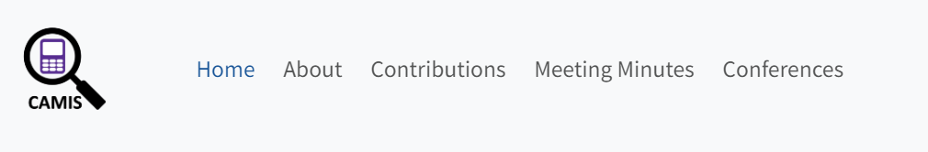
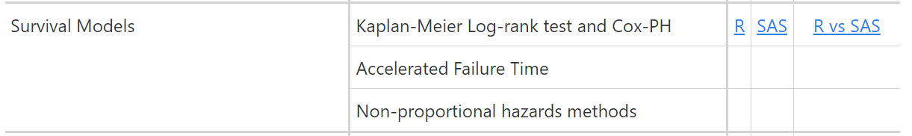
Project 12345 – Year 2023
Work icons created by Eucalyp - Flaticon
Notes:
However, lets fast forward to 2023 !!
Molly and Lyn Access the CAMIS website.
They consult the CAMIS repository Survival analysis pages, they find the problem is already documented there and hence know what to do to fix the discrepancy.
The issue is resolved & they both leave work early, having delivered a high quality package to the client.
So What is CAMIS – and what can you do to help ?

Slide 10
Welcome to the CAMIS repository !
CAMIS: Comparing Analysis Method Implementations in Software
A PHUSE DVOST working group project
A cross-industry collaboration formed of members statistical and programming associations such as PHUSE, PSI, IASCT and ASA.
Aims:
To create a white paper
To create a github repository to store how to apply statistical methods in various software and document any differences observed in the results obtained
Notes:
CAMIS stands for: Comparing Analysis Method Implementations in Software
This is a cross-industry collaboration formed of members statistical and programming associations such as PHUSE, PSI, IASCT and ASA. Anyone can be a contributor.
We have 2 Aims:
1) To create a white paper
2) To create a github repository to store how to apply statistical methods in various software and document any differences observed in the results obtained

Slide 11
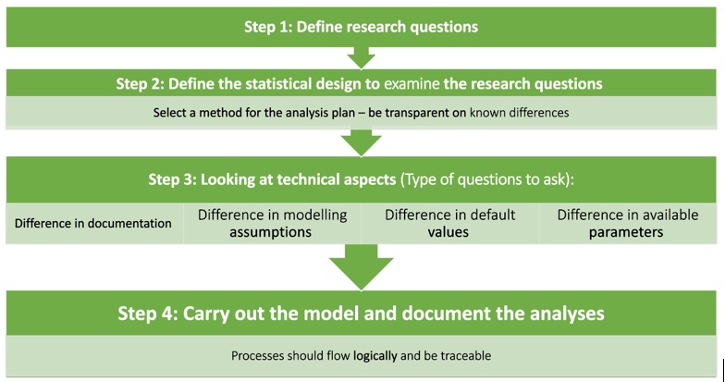
CAMIS White Paper
Notes:
The white paper describes a 4 point process to ensure analysis is clearly specified such that it isn’t reliant on software default settings which can change across software
Define the research question – often in the protocol/ SAP. Hence the first step of the analysis statistician should be to familiarise themselves with the research questions. If the clinical data scientists does not keep this in mind, the remaining steps will turn into a cycle that remains unguided in the overall purpose of the study in question
Define the statistical design to examine the research questions. The statistical designs are often informed by the protocols and procedures set in an experiment. Considerations such as estimands, randomization based on inclusion/exclusion criteria, stratified analyses, etc. help determine the model-making process.
Look at the technical aspects
basic literature search to determine how to implement the statistical models as specified. There are a variety of packages that exist that may perform the same analyses, but utilize other kinds of optimization routines in the backend. Here is a starting list of questions to consider: • Which model (and corresponding summary statistics) should be used to answer the research question based on the study design? • What are the key factors of the model, e.g. coefficient and variance estimation procedures, missing data strategy? • Can the analysis be carried out in R, or SAS, or some other platform that is available to the organization? • If the analysis can be implemented in both R and SAS, what are the differences in documentation of the key factors? These questions should be answered in context of the statistical design and be consistent with the organization’s previous practices in similar trials where applicable.
Collection of data and the question to be analyzed should be the driver for the methods of analysis. Simply a method being the “default” in your software should not be a areason to use that option !!!
4) Carry out the pre-specified analysis and display the results.

Slide 12
What kind of data scientist¹ are you?
“I did some formula work at University, but now I’m in industry I don’t have to worry about all that…..I just run the analyses available in SAS”
Is the method available in SAS, right for your data?
¹ By data scientist I mean anyone who works with data, a programmer, a statistician, PK scientist, etc…
Work icons created by Eucalyp - Flaticon
Notes:
Too much reliance on SAS and what SAS does as default – not enough on which analysis is appropriate, what assumptions you are making & check the default option is actually what you want !!

Slide 13
What kind of data scientist¹ are you?
“If a SAP doesn’t state the method fully, then it means to use the default SAS option”
Has SAS made people lazy with pre-specification of our models and assumptions?
Work icons created by Eucalyp - Flaticon
Notes:
Do we even know what software is doing anymore?

Slide 14
What kind of data scientist¹ are you?
“I love doing analysis, I just use all the default options as they must be correct”
Does time pressures mean we aren’t putting enough thought into our analyses planning?
Work icons created by Eucalyp - Flaticon
Notes:
One by product of R software coming into vision is that its forcing us to look at the full methodology being applied by the software and have a deeper understanding of the anlaysis.
It is also making us pre-specify the analysis more clearly such that the analysis can be replicated in any software with different default options !

Slide 15
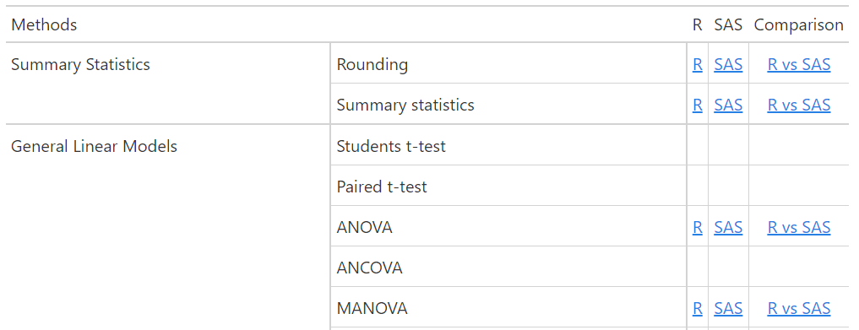
The CAMIS repository
Thanks Christina Fillmore!
https://psiaims.github.io/CAMIS/
For each Method currently completed the repository contains
Application in R
Application in SAS
Comparison between software results / noting differences
We hope to expand to include Python, Julia and/or other software
Notes:
So the repository isn’t just to showcase R… it’s to get people thinking again about what analysis you are doing… what is the software doing..
Thank you christina !
The repository is now LIVE and we are building up examples of the methods applied in R, SAS and documenting any differences between how the software performs the statistical method.
NOTE: we hope to expand to include Python, Julia & other software in the future.
When you get to the CAMIS home page, you will see a Table of methods. If a link exists then we have already created documentation for that method.
If no link exists and you have content you would like to add then please get in touch with us.

Slide 16
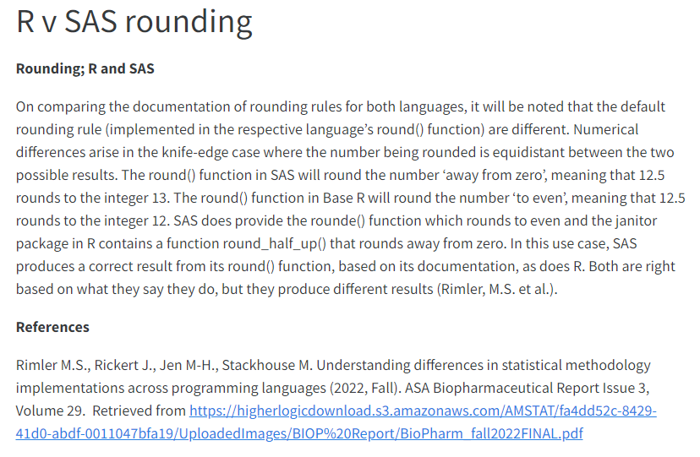
The CAMIS repository – Rounding
Number to round | Round() in R, or rounde() in sas | Round() in SAS or janitor package [round_half_up() in R]
1.2345 | 1.234 | 1.235
Notes:
For example….lets take the simple case of rounding…
The round() function in Base R will round to the nearest whole number and ‘rounding to the even number’ when equidistant, meaning that exactly 12.5 rounds to the integer 12.
This can be replicated in SAS using the rounde() option is SAS, but the more standard/default option in SAS is to use round()
The round() function in SAS will round to the nearest whole number and ‘away from zero’ or ‘rounding up’ when equidistant meaning that exactly 12.5 rounds to the integer 13.
The table shows where this rounding difference between SAS & R could be the source of obtaining different results.
Both SAS and R can have their defaults change to produce the same results.

Slide 17
The CAMIS repository – Survival Analysis
Kaplan-Meier (KM) estimators
Non-parametric statistics to estimate the survival function
Cox proportional hazards model
semi-parametric model, commonly used to assess the relationship between the survival time and explanatory variables
Log-rank test
non-parametric test to compare the survival functions of two or more groups
With Thanks to Mia Qi & Min-Hua Jen
Notes:
RE: Efron & Breslow: Both options are available in R and SAS, so by simply changing the default method, we would expect an identical HR & CI.
The key point here is that you should be considering which is most appropriate for your nalayiss, and not just using the default. Brewlow easiest to program _hence was the first to be available in SAS and hence is the default.
Efron option is more accurate if there are a large number of ties, and it is the default in R. - If number of ties are small then the methods are indistinguishable.
RE: Log, log-log : no consensus on which is best. Both are in widespread use. Simulation studies suggest log-scale interval is better – closer to the nominal coverage – which is why its’ default in R survival package
For point3, next slide

Slide 18
The CAMIS repository – Survival Analysis
Discrepancies between SAS and R can be caused by:
Default methods for handling ties in cox model are different: R uses “Efron”, SAS uses “Breslow”.
Default methods for CIs for KM estimators: R uses “log”, SAS uses “log-log”
No events after the median survival probability
SAS selects smallest event time for which the survival estimate is <0.5 (median)
R selects the mid-point of the times, with survival estimate at 50%
No events after a Landmark Estimate
SAS returns value of NE
R carries forward the survival estimates from the latest timepoint that an event occurred
With Thanks to Mia Qi & Min-Hua Jen
Notes:
RE: Efron & Breslow: Both options are available in R and SAS, so by simply changing the default method, we would expect an identical HR & CI.
The key point here is that you should be considering which is most appropriate for your nalayiss, and not just using the default. Brewlow easiest to program _hence was the first to be available in SAS and hence is the default.
Efron option is more accurate if there are a large number of ties, and it is the default in R. - If number of ties are small then the methods are indistinguishable.
RE: Log, log-log : no consensus on which is best. Both are in widespread use. Simulation studies suggest log-scale interval is better – closer to the nominal coverage – which is why its’ default in R survival package
I’ll go into point 3 & 4 in the next slides, but these aren’t the only reasons a different could exist. See the website for more detail.

Slide 19
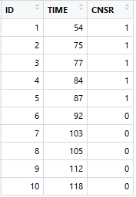
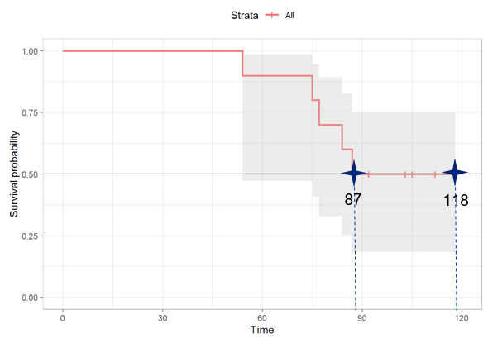
3. Median survival (R)
Reason for discrepancies in the median estimates:
Survival probability is a step function, it is possible for the curve to have a horizontal segment at exactly probability of 0.5, in which case the midpoint of the horizontal segment is returned in R: (87+118) / 2 = 102.5
With Thanks to Mia Qi & Min-Hua Jen
Notes:
The kth quantile for a survival curve is the location on the x-axis at which a horizontal line at height p = 1-k intersects the plot of survival probability.
SAS sets the median survival estimate to be NE.

Slide 20
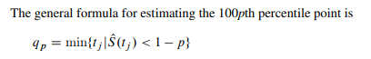
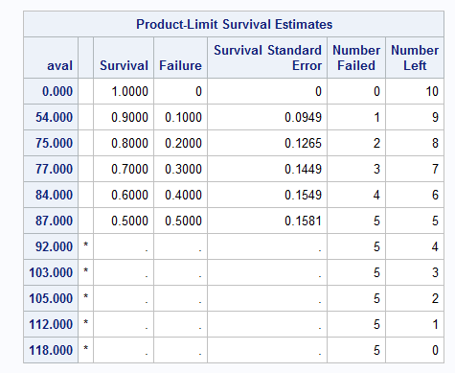
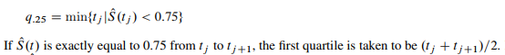
3. Median survival (R)
Reason for discrepancies
in the median estimates:
SAS searches for the smallest event time for which the survival estimate is < 0.5 (median).
This does not exist in the dataset, so SAS gives “NE”.
With Thanks to Mia Qi & Min-Hua Jen

Slide 21
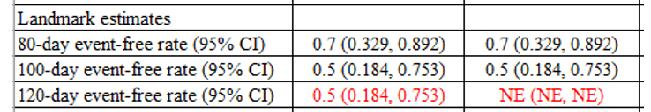
4. No event after Landmark estimate
Reason for discrepancies in the 120-day
event-free rates:
120-day is beyond the largest time in data, since it is unknown, SAS gives “NE”, but R uses the rate at the 118-day to estimate the 120-day event free rate.

Slide 22



Call for Action – How you can help?
Documenting how to perform statistical methods in R, SAS or comparing them
Adding to the repository differences between R & SAS that know about
You can be a contributor or JOIN US on the PHUSE working group
Adding content for Python, Julia or other software
Review/ revision of existing CAMIS content.
Notes:
This presentation is a call for Action - so here is how you can help us to build a high quality comprehensive repository.
Would you be interested in documenting how to perform a statistical method in R, SAS and comparing them? Our github repo has a list of issues awaiting investigation. If you would like to contribute to a specific are then please get in touch to be assigned.
Do you already have some content that you would like to load to the site which documents some difference between the was SAS and R do statistical analysis. If so please get in touch and we can show you how to load to the site
Do you want to explore other software?
Are you a statistical expert and would like to review our content to ensure our methods and documented correctly. Then please review our existing CAMIS content and do a pull request to suggest changes/ corrections.
This is a community led effort so the more people we have contributing the more comprehensive the project can become.
You can be a contributor or join the PHUSE working group which meets monthly.

Slide 23
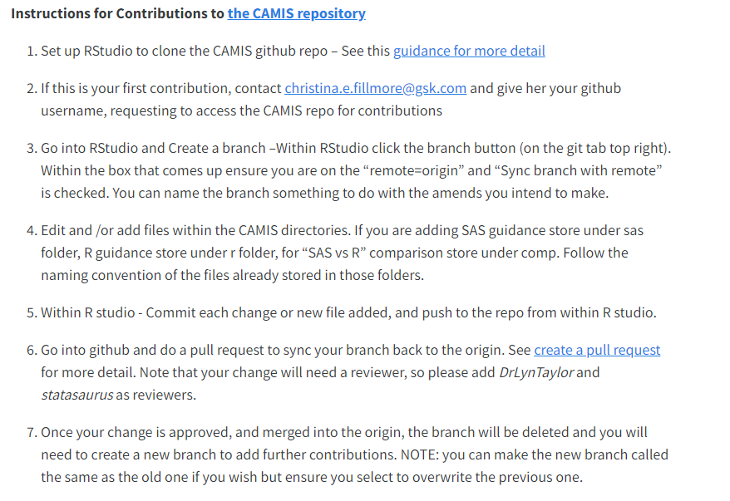
How to Contribute?
Go to the Contribution tab on the website and follow these instructions
Notes:
For instructions of how to contribute please go to the contribute Tab on the website where step-by-step instructions exist.

Slide 24
How to contact us?
psi.aims.r.validation@gmail.com
https://github.com/PSIAIMS/CAMIS/discussions
Notes:
For more information please check the website. For specific questions you can reach out to us at psi.aims.r.validation@gmail.com or at the github discussions tab: https://github.com/PSIAIMS/CAMIS/discussions

Slide 25
Thank you

Slide 26
Disclaimer
The information contained in this presentation represents the views and opinions of myself and does not necessarily represent the views or opinions of parexel.
Contributions to this talk are a result of many working groups and multiple collaborators, many of whom I will thank as I go through the slides

Slide 27
Agenda
What was stopping the use of R and What’s changed ?
Summary of working groups
R Validation Hub white paper and tools
CAMIS project
The Future collaborations

Slide 28

What was stopping the use of R in Pharma?
General belief that R could not adequately support a GXP environment
“R is open source, uncontrollable and non-static so not suitable for GxP”
“Packages can not be adequately controlled or tested”
Lack of demand by Leaders & Staff in GXP environment
Everyone uses SAS
Expensive to change
Pharma is risk averse
So why bother?
Notes:
In 2015, the PSI Board of Directors came to the PSI AIMS SIG (which I was chair of) and asked the SIG to focus their research on “What is stopping the use of R in Pharma”.
The SIG started looking at the issues and found…..

Slide 29

SAS® Software
Free Software
Fixed Version Environment
Fast to adopt new methodology
Wide functionality & easy graphics
Staff already trained to use
R community users support
Validated by SAS®
Speaks to other software
Status Quo
Interactive reporting & metadata efficiencies
SAS Customer Support
New starters (Uni levers) know R already
Notes:
If we look at the pros and cons of SAS & R,
In 2018, whilst, R remained not being used much in GxP, there was rapid growth to use it in the non-GXP area within Pharma.
This demonstrated that if we could sort the issues with environment, training & validation, then there would be demand to change.
Since the functionality in other areas was more advanced that the current SAS GRID environment.

Slide 30




Key Collaborations /Organizations
Notes:
So this is where the Collaboratios started… each with a slightly different focus and trying to resolve the bigger issues such that R use could grow in GXP.
Key collaborations / organizations leading projects in this field are:
Transcelerate is a non-profit organization with a mission to collaborate across the global biopharmaceutical research and development community to identify, prioritize, design and facilitate implementation of solutions designed to drive the efficient, effective and high-quality delivery of new medicines. Much of their work though is only shared to companies investigating resources in the collaboration so is not open source for all.
The CDISC Open-Source Alliance (COSA) supports, promotes, and sometimes sponsors open-source software projects that create tools for implementing or developing CDISC standards to drive innovation in the CDISC community.
DVOST is a working group in PHUSE which has a number of projects writing White papers on the use of open source technology. CAMIS is part of this working group.
PSI AIMS SIG: Focuses on R.
R Pharma conference.
Pharmaverse – recently brought into collaboration with PHUSE

Slide 31

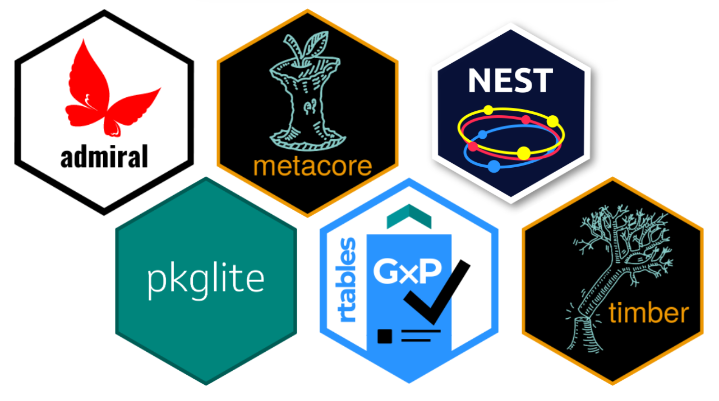
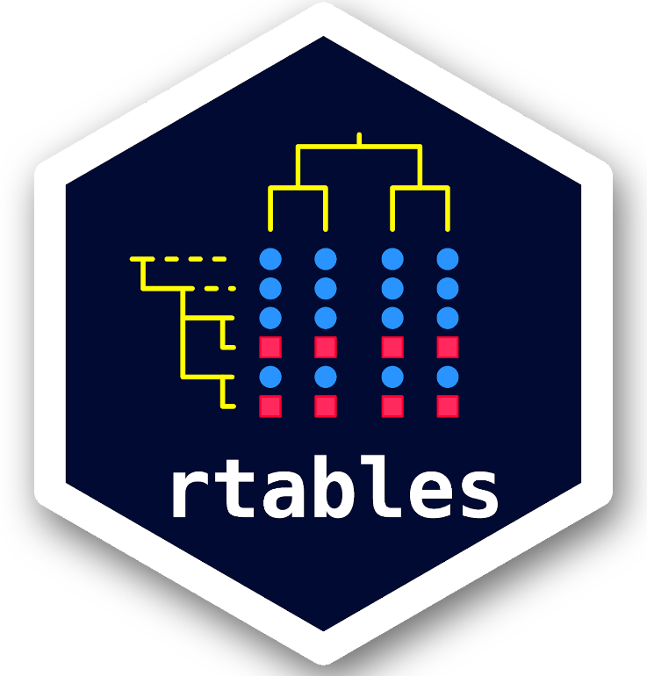
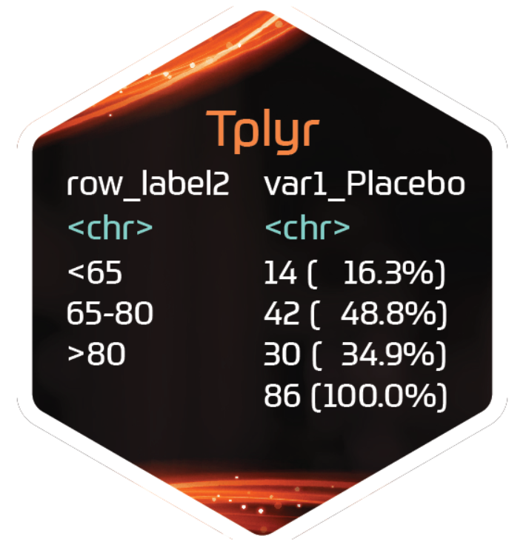


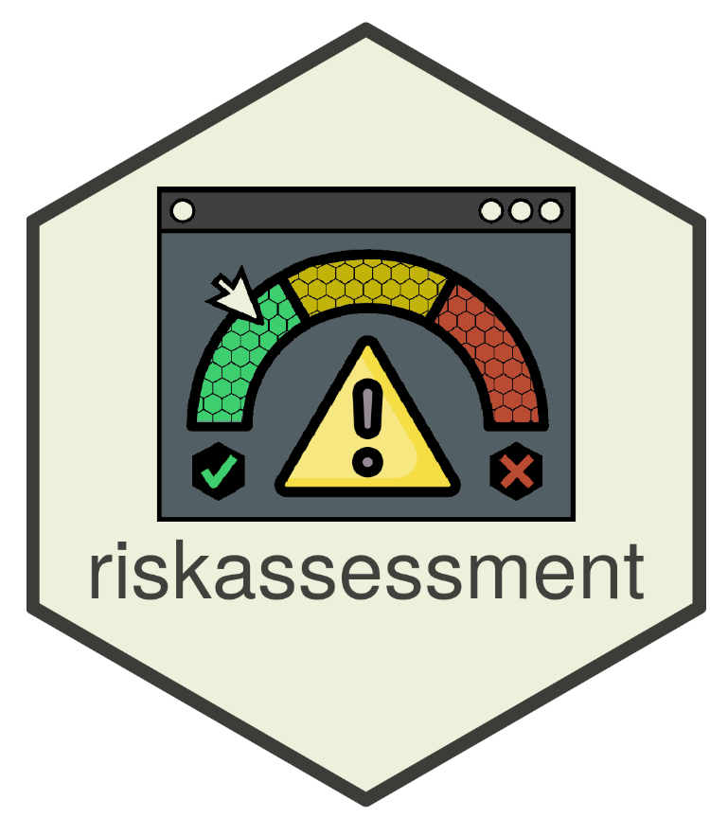
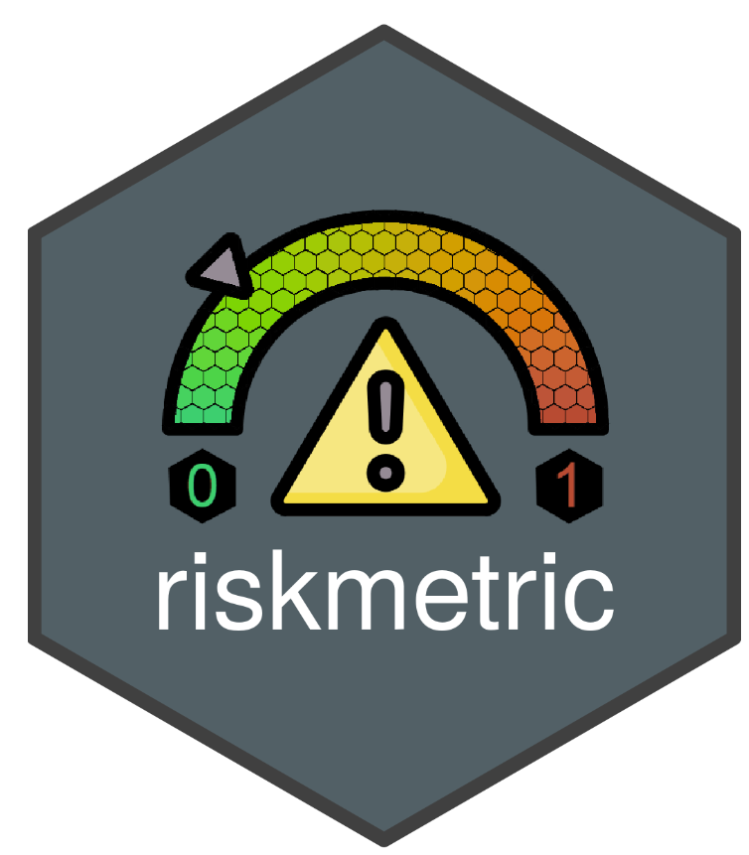
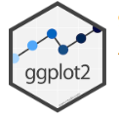

https://pharmaverse.org/
31
Notes:
Pharmaverse’s objectives is to provide: End to end clinical reporting packages in R. Initially a Roche and GSK collaboration – it’s open source and now being contributed to widely by pharma
Some key packages are shown here:
admiral: R package for programming CDISC compliant AdaM datasets in R
Thomas Neitmann (Roche). Admiralhiv/admiralvirology and admiralonco for HIV/virology (Name to be confirmed) and Oncology also in development.
Metacore - Provides an interface to read in various metadata sources and store in a standardized object and Metatools - Enables the use of metacore objects to build, enhance or check datasets using metadata
nest – Set of R packages to streamline and bring efficiency to the generation of TLGs and interactive analysis. (to come tern, teal and chevron): NOTE: not open source yet (Roche package)
Tplyr – to simplify the data manipulation necessary to create clinical reports
PharmaRTF - Enhanced RTF wrapper written in R for use with existing R tables packages such as huxtable or GT
Pkglite - To represent and exchange R package source code as text files, e.g. readable code
xportr - Serves as a single tool to create SAS transport files and perform pharma specific dataset level validation checks
Rtables - A framework for declaring complex multi-level tabulations and then applying them to data
Timber - Generates an execution log to support reproducibility and traceability of an R script
There are also many tools on package validation: covtracer (tracing code coveratge via a network of test execution, thevalidatoR – standardized build reports for validation and valtools – validation framework for R packages that allows you to bold in additional validation documentation. And diffdf – for quality checking: comparison of two data.frames (like proc compare in SAS).
Other useful packages: flextable, gt, Huxtables, mmtable2. Utility packages such as tidyverse, lintr, renv.
visR - The goal of visR is to enable fit-for-purpose, reusable clinical and medical research focused visualizations and tables with sensible defaults and based on sound graphical principles.
Ggplot2 - While ggplot2 is a lower level, non-pharma specific plotting package. It is universally accepted as the package for graphics, so included here and as a non-pharma package.

Slide 32

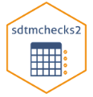

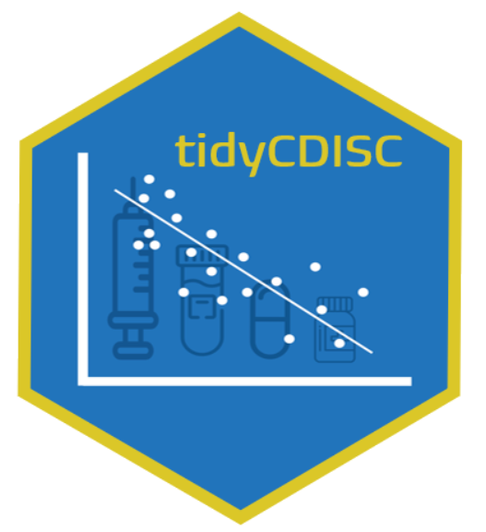






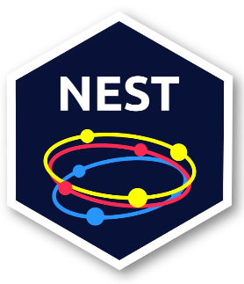


https://pharmaverse.org/
More Packages for SDTM
More Packages for ADaM
More Packages for TFLs
32
Notes:
Check their website for latest news and available packages. For example soon to be released are packages for SDTM & more packages for TFL production.
Oak– SDTM mapping algorithms and SDTMchecks2
Tern, Layers analytics from descriptive summaries to more complex statistics on top of the foundational table layouts, analytic and content controls
Teal, Framework developed that leverages the R Shiny package to scale development of our shiny apps
Chevron: Holds TLG template standards to feed into other tabulation packages
TERN TEAL & CHEVRON SIT UNDER NEST (but this isn’t open source yet).
TidyTLG - Generate table, listings, and graphs (TLG) using the Tidyverse OPEN SOURCE RELEASE EXPECTED ~MID-2022 Contact Nicholas Maselron - Holds TLG template standards to feed into other tabulation packages
Tfrmt – utilises metadata to create TFLs.
tidyCDISC A shiny app to easily create custom tables and figures from ADaM-ish data sets

Slide 33
R Tables for Regulatory Submissions Working Group (RTRS)
Goal of the working group is to create standards for creating tables that meet the requirements of FDA submission documents, and hence enhance the suitability of R for FDA submissions. https://rconsortium.github.io/rtrs-wg/
R Submissions Pilot WG
Focus on IT and platform challenges that must be addressed in order to make “all R” regulatory submissions
R Validation Hub
R Validation Hub is a cross-industry initiative whose mission is to enable the use of R by the Bio-Pharmaceutical Industry in a regulatory setting, where the output may be used in submissions to regulatory agencies.
33
Notes:
Today I’ll talk a bit about R validation Hub and Submissions activities, and Min-Hua will talk more about CSRMW project.

Slide 34
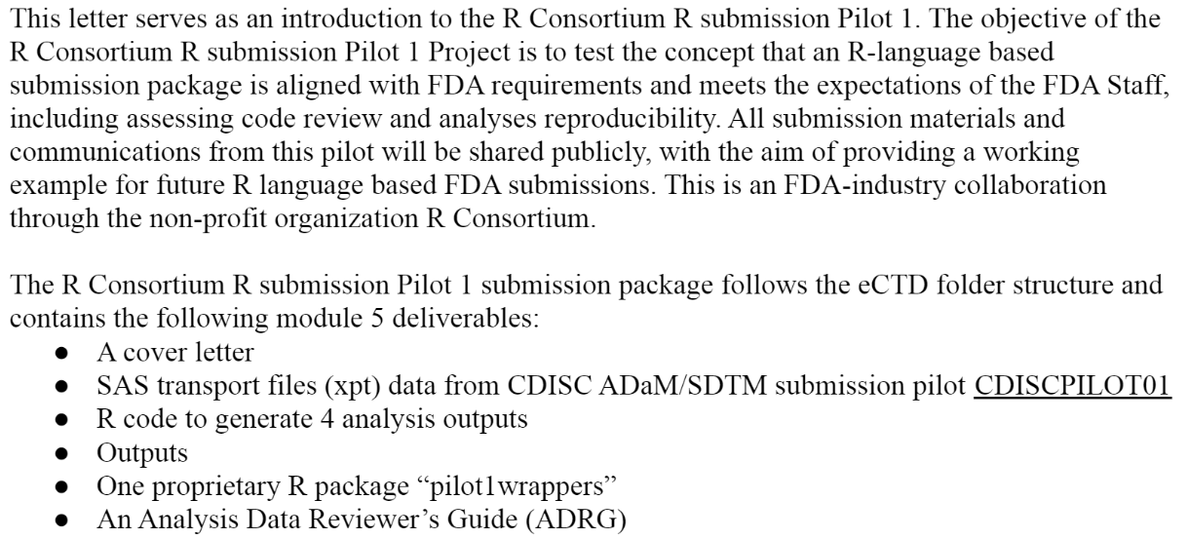
R Submission Pilot 1
Yilong Zhang (Merck) and Ning Leng (Genentech)
Submission v0.1.0 sent to FDA in Nov 2021
https://github.com/RConsortium/submissions-pilot1-to-fda
34

Slide 35
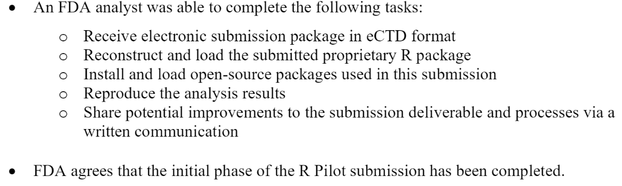
R Submission Pilot 1
FDA Response
Using R version 4.1.1, FDA was able to run the submitted code and confirm the applicant’s tables and the submitted figure in report-tlf pdf file.
Using FDA developed code, a statistical analyst was able to independently generate tables using submitted data. There are some minor issues with some of the tables that were submitted….
Version 0.1.1 was created and response provided to FDA: Feb 2022.
FDA response:
https://github.com/RConsortium/submissions-pilot1-to-fda
35

Slide 36
R Submission Pilot 2
Test the concept that a Shiny App created in R can be included into a submission package
https://github.com/RConsortium/submissions-pilot2
R Submission Pilot 3
An ADaM extension to pilot 1, eCTD format,
https://github.com/RConsortium/submissions-pilot3-adam
https://github.com/RConsortium/submissions-pilot3-adam/blob/main/vignettes/fda/R_Submission_Pilot_3_ADaM_FDA_Execution_Proposal_02Dec2022.pdf
R Submission Pilot 4 - also planned!
36

Slide 37

>100 members; >50 organizations
Mission: R Validation Hub is a cross-industry initiative whose mission is to enable the use of R by the Bio-Pharmaceutical Industry in a regulatory setting, where the output may be used in submissions to regulatory agencies.
Website www.pharmaR.org
Email to join the mailing list:
RConsortium-Validation-Hub+subscribe@lists.r-consortium.org
37
Notes:
Riskmetric App and package – Matt will be speaking about in the next talk.

Slide 38
Key Achievements 2018-2023
White Paper: A RISK-BASED APPROACH FOR ASSESSING R PACKAGE ACCURACY WITHIN A VALIDATED INFRASTRUCTURE. Andy Nicholls (GSK), Paulo Bargo (Janssen R&D) and John Sims (Pfizer)
{riskmetric} package – risk metrics to evaluate the quality of R packages Doug Kelkoff (Roche) and Yilong Zhang (Merck) – now led by Eric Milliman (Biogen) https://pharmar.github.io/riskmetric/
{riskassessment} app – Application for riskmetric package Marly Cormar (Biogen) - now led by Aaron Clark (Biogen) https://github.com/pharmaR/risk_assessment
R Adoption series of talks
https://www.pharmar.org and email to join the mailing list:
RConsortium-Validation-Hub+subscribe@lists.r-consortium.org
38
Notes:
Riskmetric App and package – Matt will be speaking about in the next talk.
Blog posts/presentations/case studies: www.pharmaR.org
ASA BIOP report publication (Vol29, No.3 Fall 2022). Risk Assessment of R Packages: Learnings And Reflections

Slide 39
White Paper
Provides arguments that there is minimal risk in using Core R for regulatory analysis and reporting
Suggests a pipeline for risk-based assessment of contributed R packages based on
Intended use
Type of implemented method
Maintenance quality
Community usage
Remediation and testing
Contributed
Recommended
Base
Popular
https://www.pharmar.org/white-paper/
With Thanks to Andy Nicholls.
Notes:
base and recommended (core) packages - developed by the R Foundation and shipped with the basic installation
contributed (open source) packages - developed by anyone, and may differ in accuracy

Slide 40
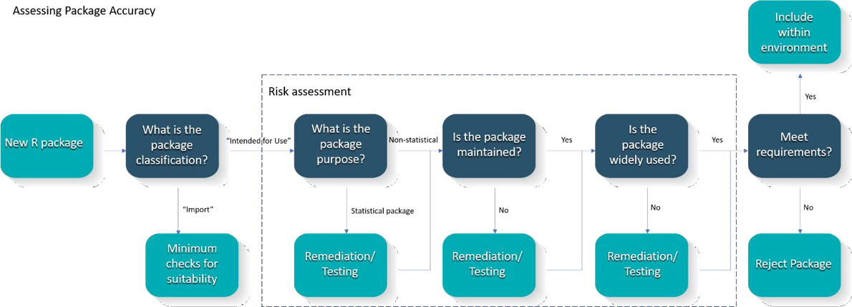
White Paper
https://www.pharmar.org/white-paper/
With Thanks to Andy Nicholls.
Notes:
To review those resources, lets start with the white paper
Suggests a pipeline for risk-based assessment of contributed R packages
For Core R (base and recommended packages), the R Foundation has provided a guidance document on regulatory compliance and validation issues. Based on that, it can be concluded that there is minimal risk in using Core R for regulatory analysis and reporting
For contributed R packages there is a large variation of quality, robustness, and trustworthiness. CRAN passes a series of technical checks, but these do not necessarily guarantee the accuracy of the package.
The RvalHub outlines a framework to assess the accuracy of R packages and document that process
It recommends to focus on the way that components of the system will be used.
Higher standards for packages implement statistical methods or algorithms
Consider Maintenance of Good Practice (Software Development Life Cycle)
But also Community usage and Testing coverage

Slide 41
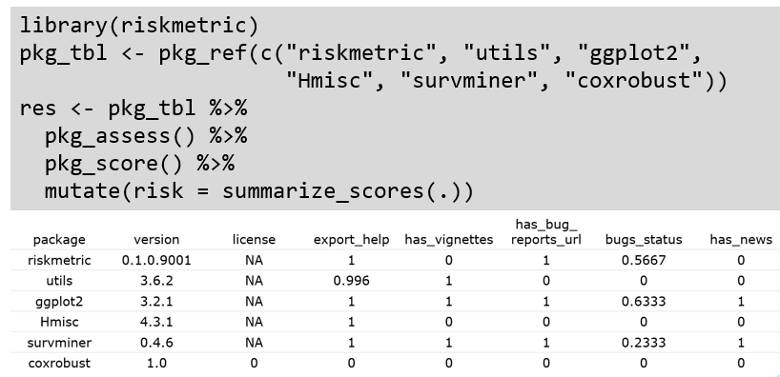
{riskmetric} package
Notes:
The {riskmetric} R package supports risk-based validation R packages.
Its an interface to collect package information from a
variety of sources such as public package repositories, public source code repositories, local source code or locally installed package libraries
pkg_ref(): builds a collection of package metadata which may be helpful for a risk assessment.
pkg_assess(): derives a number of package metrics from this metadata
Finally, pkg_score() consolidates the metrics into numeric indications of their quality and allowing for aggregate comparison of individual packages or package cohorts.

Slide 42
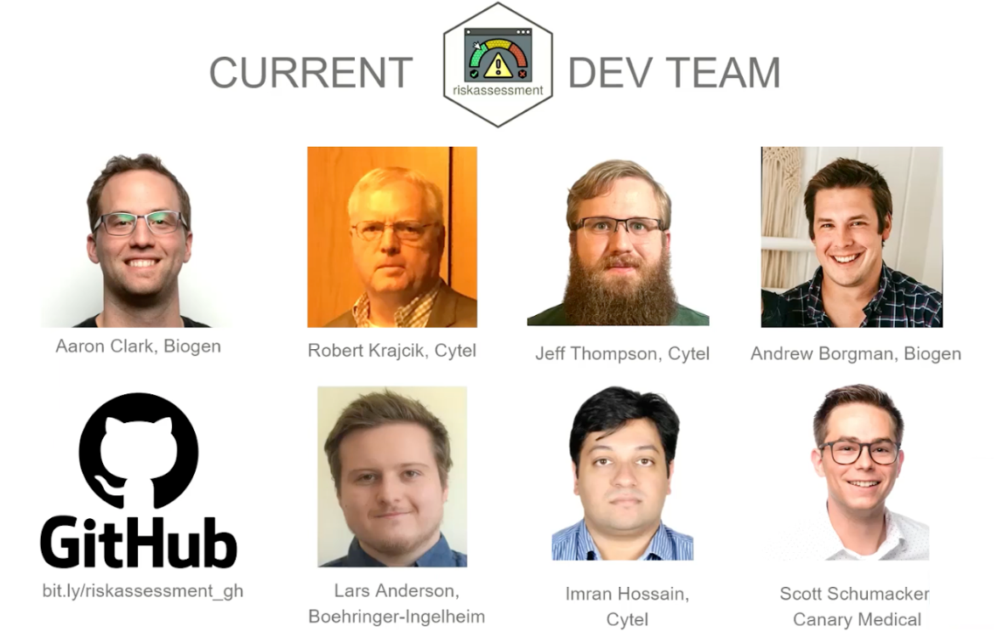
{riskassessment} app
Voted best Shiny app at shinyConf 2023!
The Demo app: https://rinpharma.shinyapps.io/riskassessment/
GitHub: https://github.com/pharmaR/riskassessment
User guide: https://pharmar.github.io/riskassessment/
Get Involved: https://pharmar.org
The 2nd Annual Shiny Conference was held March 15-17, 2023. It was all-virtual with over 4k global registrants. Aaron Clark, from the R Validation Hub Executive Committee, presented on the {riskassessment} app.
Notes:
The shiny application has the following functionalities:
- inherits the advantages of the shiny R package, i.e. no R programming knowledge is needed to use the application,
- gathers information on community and maintenance metrics of the package,
- has embedded authorized personnel that can perform risk assessments and modify metric weights depending on the user access level,
allows users to provide feedback on the risk calculated by riskmetric,
stores historical comments and final decisions,
- contains a reporting tool that allows users to share the assessment insights with other reviewers as either a Word Document or an HTML file

Slide 43
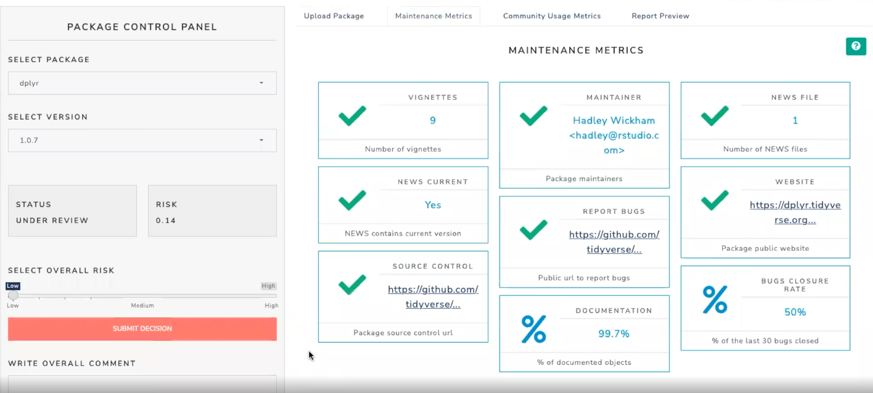
Risk Assessment App
Notes:
This is our view once we have selected a package…

Slide 44
R adoption Examples
Organized by Juliane Manitz
2022 All-Hands Case Studies https://github.com/pharmaR/case_studies
Merck
Novartis
Roche
2023 PSI Conference Adoption Examples https://psiweb.org/docs/default-source/psi-events---member-only-access/using-r-for-regulatory-work-(combined-slides).pptx?sfvrsn=7700a3db_0
GSK
PHASTAR
https://www.pharmar.org/casestudies/
Notes:
The Roche repositories

Slide 45
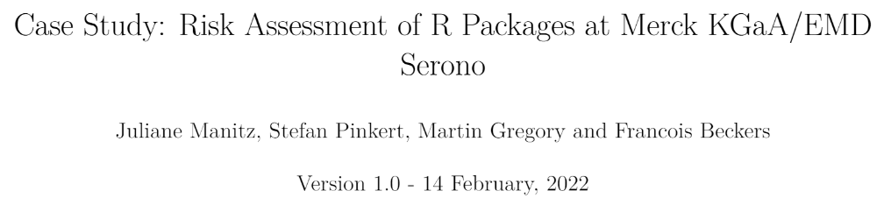
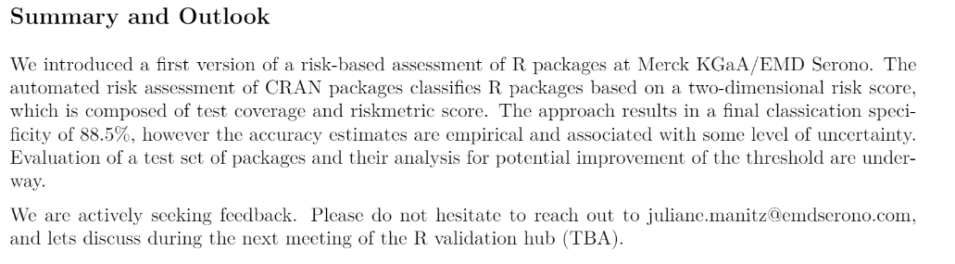
2022 All-Hands Case Studies for R adoption
case_studies/Merck_KGaA_Rpkg_validation_220202.pdf at main · pharmaR/case_studies (github.com)

Slide 46
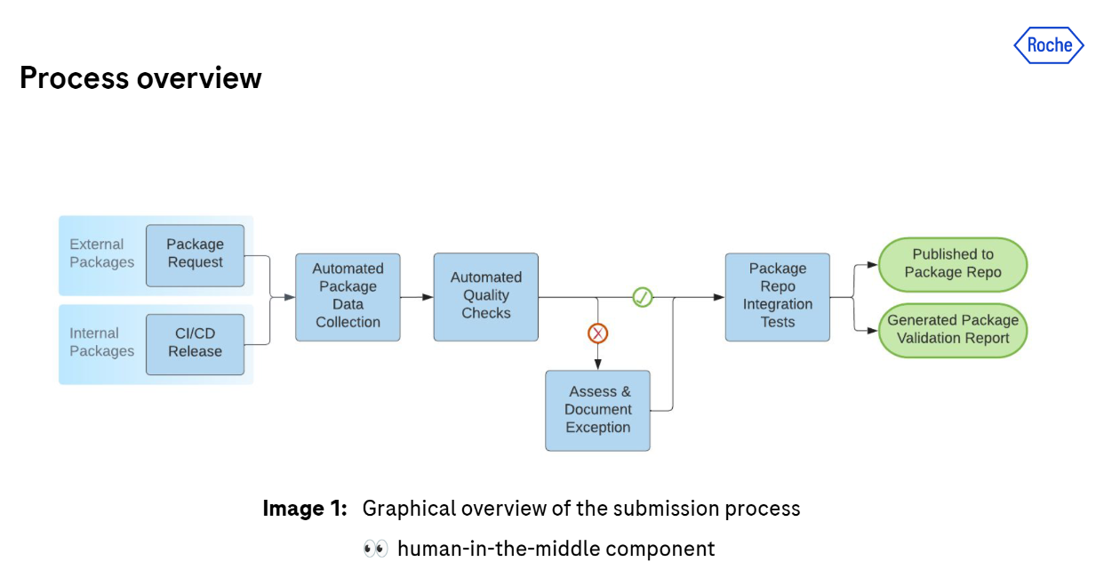
2022 All-Hands Case Studies for R adoption
– see also Roche repo: https://github.com/orgs/Roche/repositories
case_studies/Roche_Rpkg_validation_2022.pdf at main · pharmaR/case_studies (github.com)
Notes:
The Roche repository contain number R and Python code designed for pharma use.

Slide 47
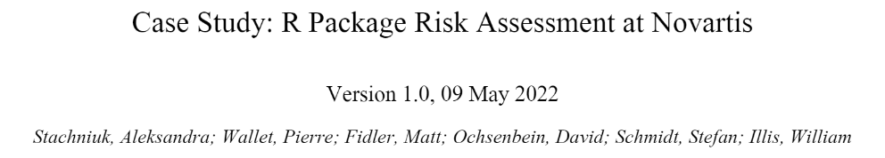
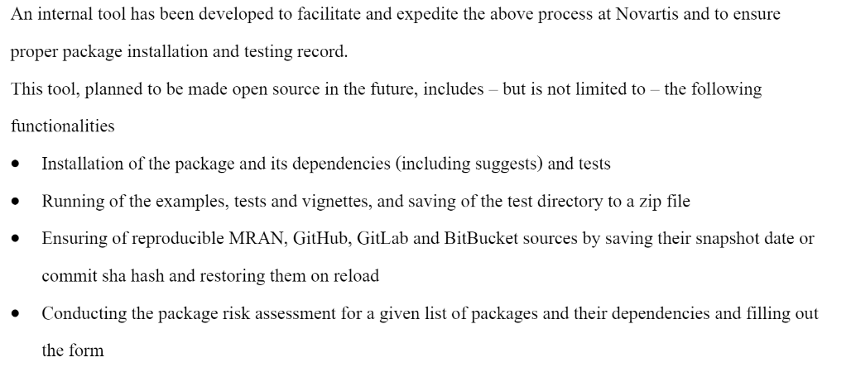
2022 All-Hands Case Studies for R adoption
case_studies/Novartis_Rpkg_validation_20220509.pdf at main · pharmaR/case_studies (github.com)

Slide 48
R Adoption: Common Themes
All implementations follow the risk validation process for R packages as outlined in the white paper
Classification of package quality into high/medium/low or a binary high/low categorization, however the approach to the assessments themselves varies.
High importance of test coverage as assessment metric
Trusted resources: R Foundation, thus core R (base and recommended packages) are treated as a collective of “low risk” packages; some organizations also trust Rstudio developments, i.e. tidyverse, etc.
The majority focused risk assessments only on “Intended-for-Use” packages but several also ran metrics on the Imports.

Slide 49
R Adoption: Differences in Approaches
Varied degrees of automation in risk classification and qualification i.e. either complete automation or no automation
Different weights were assigned to the testing coverage and various suggested metadata metrics: acceptable threshold for test coverage ranges between 50-80% for low-risk packages
Different risk remediation strategies have been applied:
some organizations will immediately introduce their own unit tests,
others restrict package use to only the tested subset of package functionality.

Slide 50
R Adoption: Common Challenges
R package assessment is a resource-intense activity
Time has proven to be a considerable challenge.
Ensuring R package reviewers have the right technical expertise
Alignment of different contributors across the organization: IT, Quality Assurance and with their own Statistics, Data Science, or Programming lines.
Finding appropriate test datasets, test cases and expected model output
Long-term management and maintenance as well as oversight of the risk-based package assessment process

